Slide 1
A Study of Privacy and Anonymity in the DNS*
Cesar Ghali, Gene Tsudik, Christopher A. Wood
University of California Irvine DNS OARC – Dallas 2016
*Support provided by Verisign

Slide 2
Pitiful Privacy in the DNS
Encryption only protects query contents [1,2,3]
Side channels are prevalent in the protocol [2]:
Timing
Frequency
Response sizes
Resolution chains
[1] Bernstein, Daniel J. "DNSCurve: Usable security for DNS." dnscurve. org (2009).
[2] Shulman, Haya. "Pretty bad privacy: Pitfalls of DNS encryption." Proceedings of the 13th Workshop on Privacy in the Electronic Society. ACM, 2014.
[3] DNS-over-HTTPS, Google. https://developers.google.com/speed/public-dns/docs/dns-over-https

Slide 3
Plugging Privacy Holes
Message padding [size]
Message interleaving [frequency, time, chains]
Artificial resolver delays [time]
Query chaffing [frequency]

Slide 4
But Wait… There’s More
For privacy, we want to protect the contents of a query from Adv (resolver or stub)
What about the sources of the queries?
Can queries reveal information about the origin?

Slide 5
Agenda
DNS privacy mitigations*
Message padding [size]
Message interleaving [frequency, time, chains]
Artificial resolver delays [time]
DNS client anonymity
Analysis
Query chaffing countermeasure [frequency]
*Strategies implemented in an open source DNS resolver

Slide 6
PRIVACY

Slide 7
Adversarial Model
S₁
QUERY .com
QUERY www.example.com
C
R
QUERY example.com
S₂

Slide 8

Adversarial Model
S₁
QUERY .com
QUERY www.example.com
C
R
QUERY example.com
snoop
query
snoop
S₂

Slide 9
Adversarial Model
S₁
QUERY .com
QUERY www.example.com
C
R
What’s inside this query?
QUERY example.com
snoop
query
snoop
S₂

Slide 10
Message Padding [size]
Ideal requirements:
Must fit within UDP packet (or TLS record)
What if a request or response exceeds the MTU?
Must not be more than what’s necessary
What’s the maximum padding length?

Slide 11
EDNS(0) Padding [1]
Clients and servers can specify padding length in messages
Method of padding selection is left unspecified
[1] https://tools.ietf.org/html/rfc7830

Slide 12
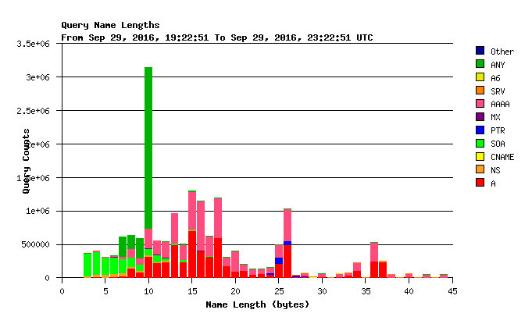
Maximum QNAME Size

Slide 13
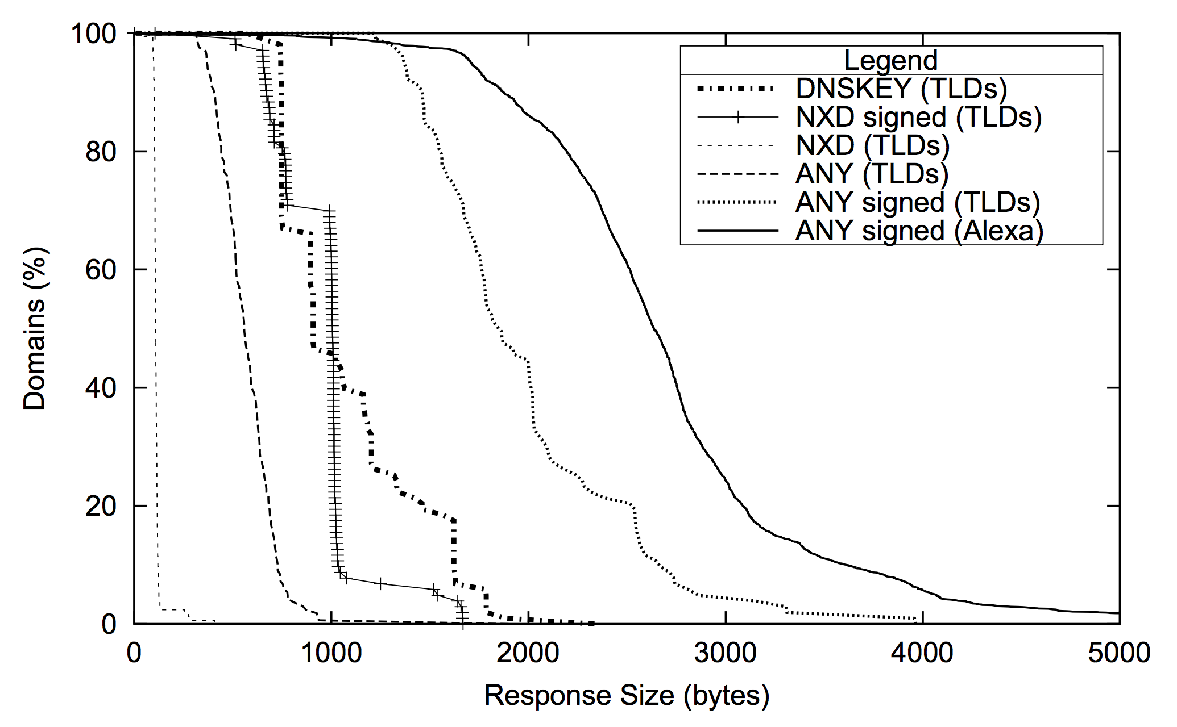
Maximum Response Size
Standard MTU

Slide 14
Maximum Response Size
Standard MTU
Where’s the end?

Slide 15
Padding Choices
Ideally: padding is uniform
Tradeoff: break responses into ”sized tiers”
Size ∈ [1,100] => Tier 1
Size ∈ [101,200] => Tier 2
…
Size > X => Tier N
Notes:
So under these conditions, how do we apply padding?

Slide 16
Boundaries
How can tier boundaries be selected such that privacy is increased while overhead is decreased?
Fewer tiers => more privacy, more overhead
More tiers => less privacy, less overhead

Slide 17
Boundaries
How can tier boundaries be selected such that privacy is increased while overhead is decreased?
Fewer tiers => more privacy, more overhead
More tiers => less privacy, less overhead
Build tiers dynamically based on (cumulative) distribution of requests

Slide 18
Padding Tiers

Slide 19
Padding Tiers

Slide 20
Padding Tiers
Notes:
Ns-oarc, reply length, last month
#tiers is fixed, boundaries move back and forth

Slide 21
Message Interleaving [frequency, time, chains]
Requirements: mask query order by interleaving messages
Cannot interleave unless we batch queries
Want to minimize query delays while maximizing interleaving
Approach:
Batch for RTT* seconds
Shuffle packets (queries and responses), send in sequence, repeat
*Average RTT to resolve a single query
Notes:
- Idea behind message interleaving is 2 fold: hide frequency, and make resolution chains harder to put together based on packet analysis -- basically mixnet

Slide 22
Message Interleaving Overview
Stub
Client
Q1
Client
Q2
Resolver
(mixer)
Stub
Q3
Client
Q3
Q2
Q1
Stub

Slide 23
Message Interleaving Overview
Stub
Client
Q1
Client
Q2
Resolver
(mixer)
Stub
Q3
Client
Q3
Q2
Q1
shuffle
Stub

Slide 24
Message Interleaving Overview
Stub
Client
Q1
Q1
Client
Q2
Resolver
(mixer)
Stub
Q3
Client
Q2
Q3
Q1
Stub

Slide 25
Message Interleaving Overview
Stub
Client
Q1
Client
Q2
Resolver
(mixer)
Q3
Stub
Q3
Client
Q2
Q3
Q1
Stub

Slide 26
Message Interleaving Overview
Stub
Client
Q1
Client
Q2
Resolver
(mixer)
Stub
Q3
Q2
Client
Q2
Q3
Q1
Stub

Slide 27
Results
Notes:
Using the same packet trace, modified it such that the packets were sent according to the sliding RTT window

Slide 28
Results

Slide 29
Results
Batching and interleaving has no useful effect on average query resolution time
Notes:
- if no effect on query resolution time, then no effect on perceived frequency either (so it was ineffective). we also postulate that it has little effect on the resolution chains, too

Slide 30
Artificial Resolver Delays [time]
Requirements: introduce artificial delays in resolvers to mask timing side channels (even with RANSes)
Approach:
If data not cached, resolve the request and record the RTT
Else, wait for the previously recorded RTT before returning the response
Notes:
Perceived effect for the client is that there is no cache

Slide 31
Delay Effects

Slide 32
Delay Effects
Simple delays mask the presence of any upstream caches

Slide 33
Side Effects and Questions
Worst-case latency for clients
Is < 0.1s noticeable?
Per-record query delays can reveal information about different resolution strategies
Should the delay always be the worst case across all records?

Slide 34
Anonymity

Slide 35
Adversarial Model
S₁
C₁
QUERY .com
QUERY www.example.com
R
C₂
QUERY example.com
S₂

Slide 36
Adversarial Model
S₁
C₁
QUERY .com
QUERY www.example.com
R
C₂
QUERY example.com
S₂

Slide 37
Adversarial Model
S₁
C₁
QUERY .com
QUERY www.example.com
Who generated this query?
R
C₂
QUERY example.com
S₂
Notes:
- Adv model: we show Adv as just a single node, but it could be multiple colluding stubs who use their recorded information to try and identify clients -- the idea is that the clients hide behind resolvers, and we want to know if that's enough

Slide 38
De-Anonymizing Attack
Goal: use information in queries to link them to specific clients
Many features to choose from:
Query length
Query target name
Query frequency (windowed)
Query single component differences
Query entropy
Query target address
…
Other possibilities:
Resolution chain (not visible to stub adversary)

Slide 39
Approach
Data
Capture DNS packet traces for small set of users over a single day for numerous days
One day becomes training data, the rest is test data
Computation
for classifier in classifiers: for feature_set in combinations(features): classifier.train(feature_set, training_data) error_rate = classifier.process(feature_set, live_data)

Slide 40
Classifiers
We sampled a number of classifiers:
SVM
Linear classifier (logistic regression)
SGD (stochastic gradient descent)
Decision Tree

Slide 41
Results*
Classifier | Feature(s) | Error Rate
Linear | Query length | 0.5185
SVM | Query length | 0.5076
SGD | Query length | 0.5077
Linear | Query length, query frequency | 0.6042
SVM | Query length, query frequency | 0.5895
SGD | Query length, query frequency | 0.5425
Linear | Query length, query frequency, query target name | 0.5293
SVM | Query length, query frequency, query target name | 0.5224
SGD | Query length, query frequency, query target name | 0.5342
*subset of the entire result set

Slide 42
Results*
Classifier | Feature(s) | Error Rate
Linear | Query length | 0.5185
SVM | Query length | 0.5076
SGD | Query length | 0.5077
Linear | Query length, query frequency | 0.6042
SVM | Query length, query frequency | 0.5895
SGD | Query length, query frequency | 0.5425
Linear | Query length, query frequency, query target name | 0.5293
SVM | Query length, query frequency, query target name | 0.5224
SGD | Query length, query frequency, query target name | 0.5342
None of these features are helpful
(and that’s good)
*subset of the entire result set

Slide 43
Query Chaffing
Requirements:
Chaffing should look similar to existing queries
Rate should resemble legitimate traffic
Idea:
Using DNS packet traces, build a weighted directed graph of domain relationships
Sample chaff traffic from neighbors of past queries

Slide 44
Domain Graphs
G = (V,E) such that
V is the set of domains (QNAMEs)
(u∈V, v∈V)∈E iff v is queried after u from the same address
Implies that there is some relationship between the two domains
twitter -> facebook -> youtube

Slide 45
Example

Slide 46
Approach
Perform random traversal of the domain graph
Advance at the average query rate

Slide 47
Results

Slide 48
Wrapping Up
Examined privacy-enhancing mechanisms have marginal (if any) benefits
Artificial cache delays: only measure that seems to truly help while being minimally intrusive
Anonymity (against the limited adversary) seems safe
Stronger adversaries (closer to the clients) will have an easier time
Query chaffing helps unify traffic patterns but at significant cost

Slide 49
Questions? Fire away!

Slide 50
Special thanks to Verisign for their support of this work!

